Slide 1
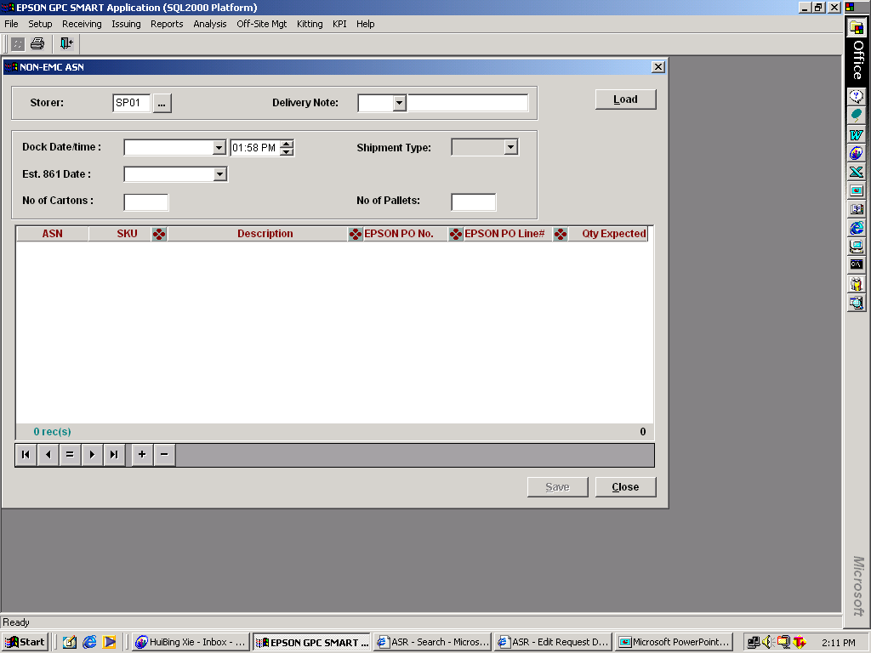
Insert additional column: COO

